Slide 1
Futures Café
Enabling staff and student innovation & enterprise
Welcome and opening remarks
Dr Lesly Huxley

Slide 2
Programme: Enabling innovation & enterprise
14.00 Welcome & opening remarks
Dr Lesly Huxley, IT Services R&D/ILRT, Dr John Manley, formerly HP Labs
14.15 Current practice, future aspirations
Dr Liz Holcombe, Lecturer, Civil Engineering
Dr Phil Langton, Senior Lecturer Physiology & director of education
innovation
Paul Walk, Head of technology strategy and planning, EDINA
Nick Sturge, Business incubator manager, RED
15.30 Refreshments
16.00 Discussion: How should IT Services enable innovation and enterprise in future?
(Chair: Dr John Manley)
17.00 Close

Slide 3
Definitions (1)
Innovation [noun]
  [mass noun] the action or process of innovating: innovation is crucial to the continuing success of any organization
  [count noun] a new method, idea, product, etc.: technological innovations designed to save energy
  Oxford dictionaries: http://oxforddictionaries.com/definition/english/innovation

Slide 4
Definitions (2)
Enterprise [noun]
  1 a project or undertaking, especially a bold or complex one. [mass noun] initiative and resourcefulness
  2 a business or company: [mass noun]
  entrepreneurial economic activity: an economic environment which encourages enterprise

Slide 5
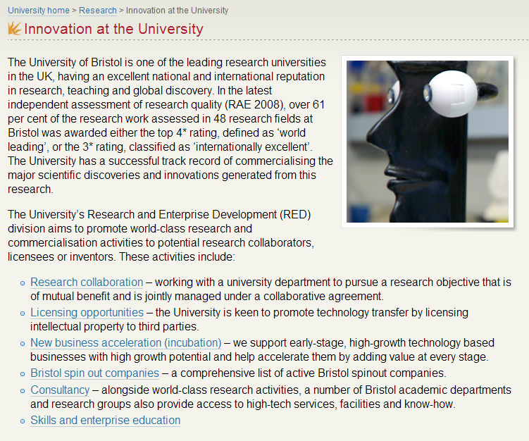
Innovation cuts across research, commercialisa-tion, business and education

Slide 6
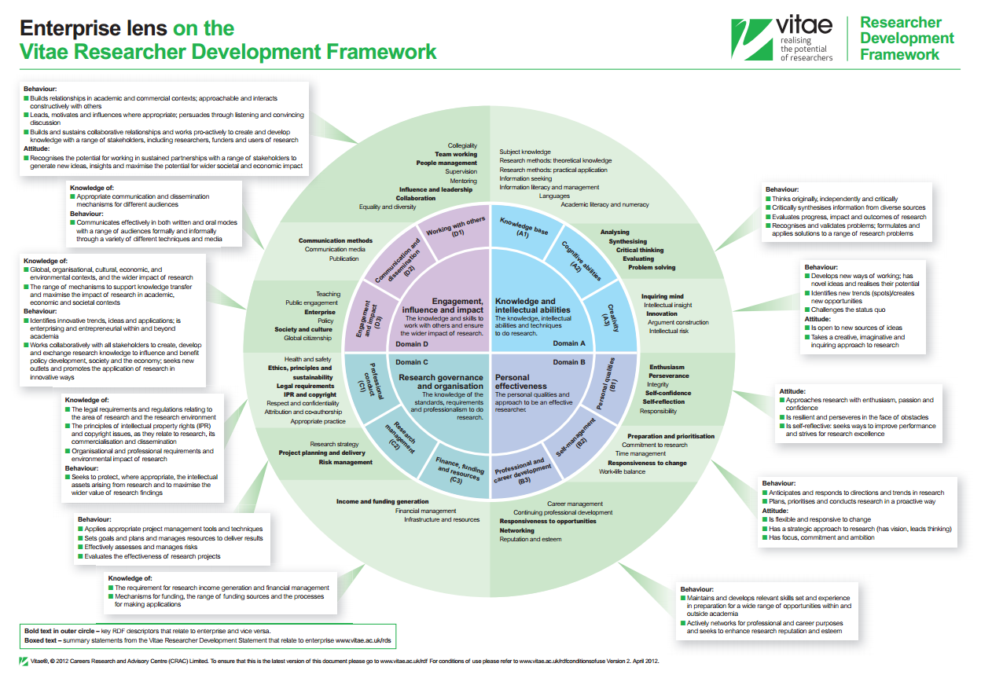

Slide 7
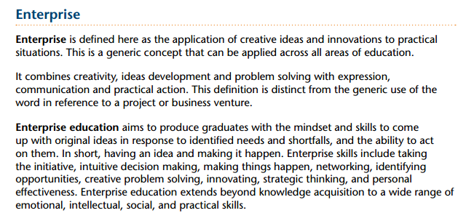

QAA: Enterprise and entrepreneurship guidance
Sep-2012

Slide 8
Futures Café
Enabling staff and student innovation & enterprise
Welcome and opening remarks
Dr John Manley

